Slide 1
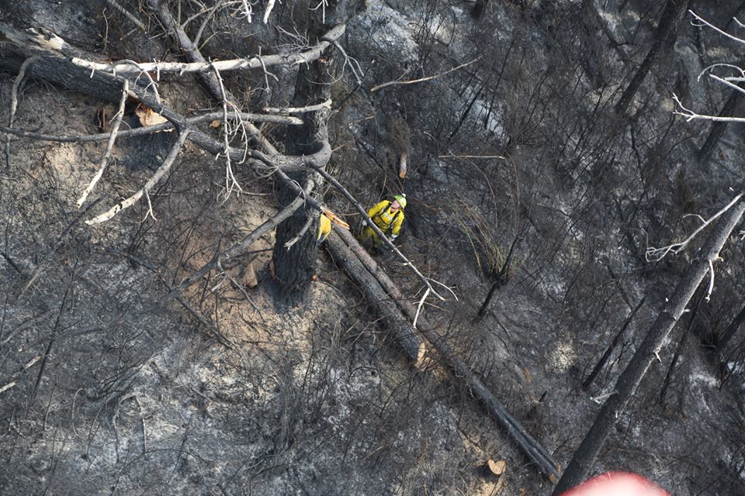
Our Community
Pauatahanui Residents Association

Slide 2
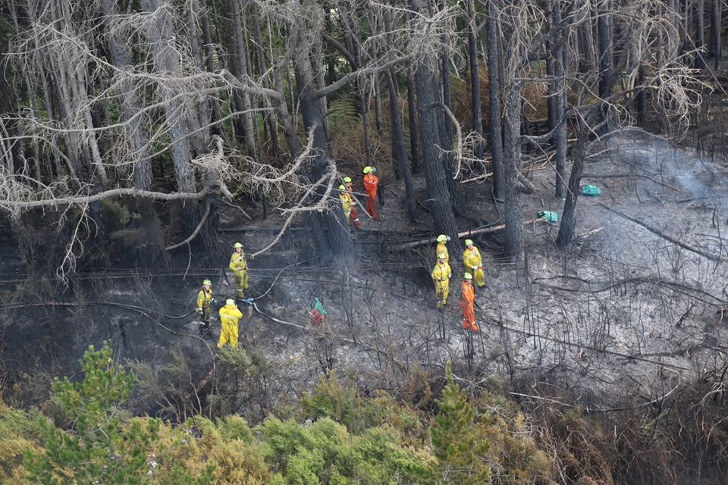
WHO
ARE WE?
One rural fire district across the Wellington region (excluding the Wairarapa)
One team dedicated to the reduction, readiness, response and recovery of fires in the rural area

Slide 3
WHAT
Do WE DO?
Community engagement, training of fire fighters, permitting process, operational readiness
Work with key partners like the Fire Service, Councils and DOC

Slide 4
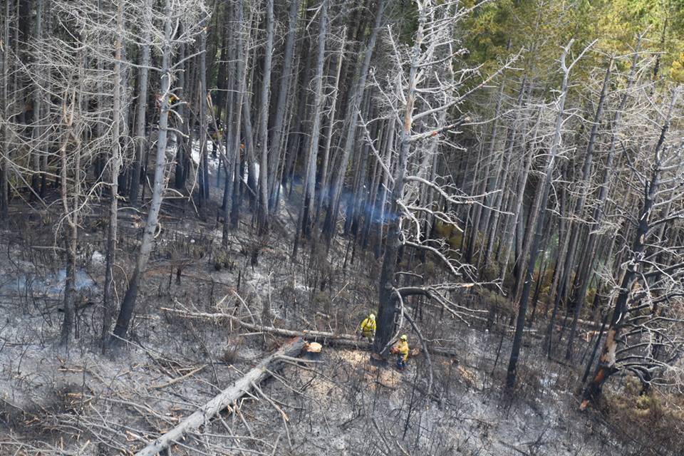
FIRE SAFETY
AT HOME
Fire permits if burning in the open
Addresses clearly marked
Access ways clear
Water availability
Connected with neighbours

Slide 5
OTHER
PROJECTS
Water tank kits
Work with Councils to include fire prevention initiatives in Bylaws and building codes

Slide 6
CONTACTING
US
www.wrfa.org.nz
facebook: Wellington Rural Fire Authority
04 237 9613

